Slide 1
Econometrics of Firm Data
Exercise Class 2 – Problem Sets 3 + 4
Mette Suder Franck, msf.eco@cbs.dk
DVIP, Department of Economics

Slide 2
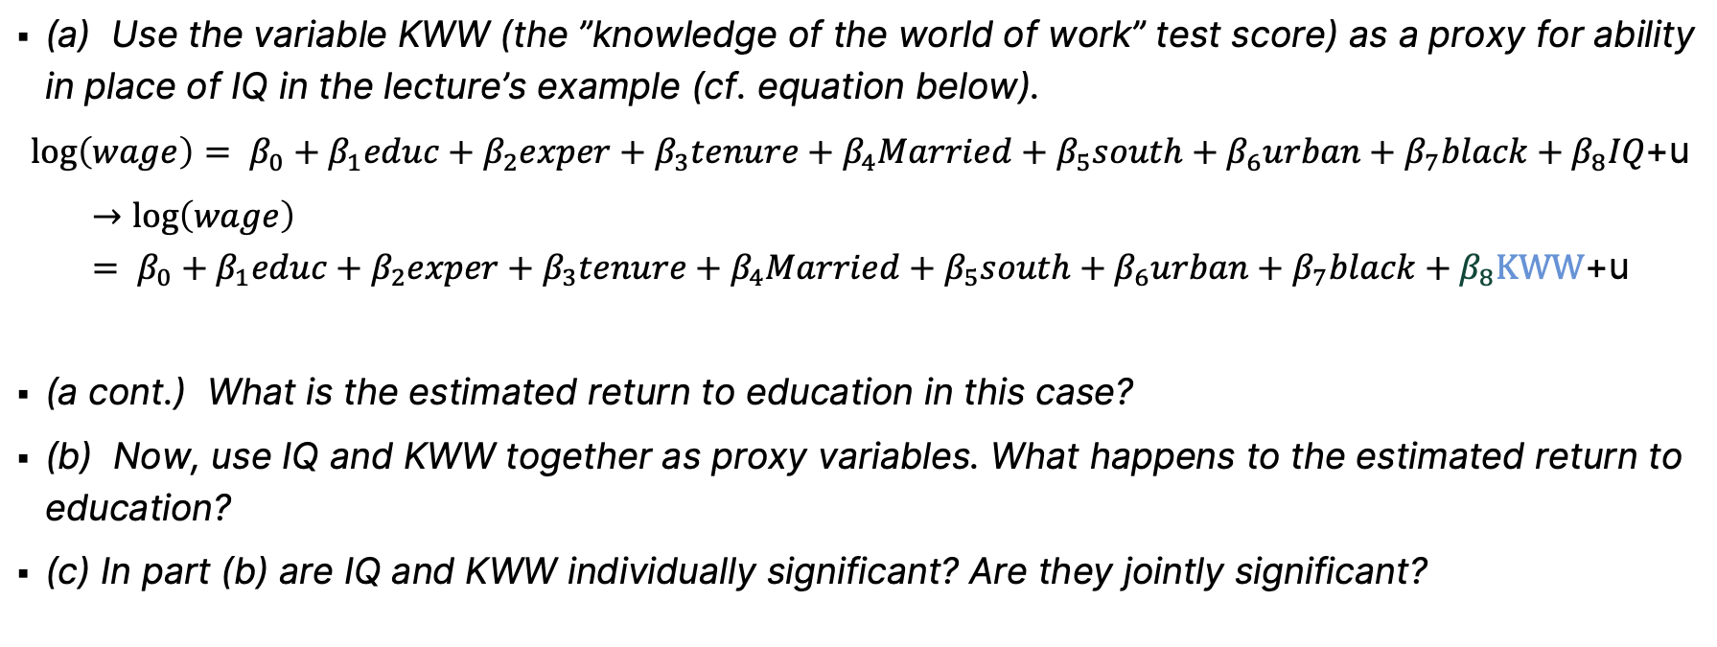
Problem Set 3 – Proxy and Instrumental Variables
Exercise 3.1
(a) Use the variable KWW (the ”knowledge of the world of work” test score) as a proxy for ability in place of IQ in the lecture’s example (cf. equation below).
$$\log\left(wage\right)= β_{0}+β_{1}educ+β_{2}exper+β_{3}tenure+β_{4}Married+β_{5}south+β_{6}urban+β_{7}black+β_{8}IQ\text{+}\text{u}$$
$$→\log\left(wage\right)= β_{0}+β_{1}educ+β_{2}exper+β_{3}tenure+β_{4}Married+β_{5}south+β_{6}urban+β_{7}black+β_{8}\text{KWW}\text{+}\text{u}$$
(a cont.) What is the estimated return to education in this case?
(b) Now, use IQ and KWW together as proxy variables. What happens to the estimated return to education?
(c) In part (b) are IQ and KWW individually significant? Are they jointly significant?
Note: Use WAGE2.dta for this exercise.

Slide 3
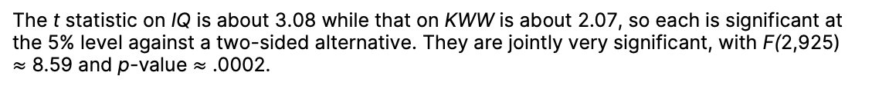
Problem Set 3 – Proxy and Instrumental Variables
 | (1) | (2) | (3)
VARIABLES | IQ - lecture | KWW | IQ and KWW
educ | 0.0544*** | 0.0576*** | 0.0498***
 | (0.00693) | (0.00684) | (0.00726)
exper | 0.0141*** | 0.0122*** | 0.0128***
 | (0.00317) | (0.00324) | (0.00323)
tenure | 0.0114*** | 0.0111*** | 0.0109***
 | (0.00244) | (0.00246) | (0.00245)
married | 0.200*** | 0.189*** | 0.192***
 | (0.0388) | (0.0391) | (0.0389)
south | -0.0802*** | -0.0916*** | -0.0820***
 | (0.0263) | (0.0262) | (0.0262)
urban | 0.182*** | 0.176*** | 0.176***
 | (0.0268) | (0.0270) | (0.0269)
black | -0.143*** | -0.164*** | -0.130***
 | (0.0395) | (0.0385) | (0.0399)
IQ | 0.00356*** |  | 0.00312***
 | (0.000992) |  | (0.00101)
KWW |  | 0.00503*** | 0.00383**
 |  | (0.00182) | (0.00185)
Constant | 5.176*** | 5.359*** | 5.176***
 | (0.128) | (0.114) | (0.128)
Observations | 935 | 935 | 935
R-squared | 0.263 | 0.259 | 0.266
Joint signif. F |  |  | 8.595
Joint signif. p-val |  |  | 0.000200
Standard errors in parentheses
*** p<0.01, ** p<0.05, * p<0.1
Exercise 3.1
(a) What is the estimated return to education in this case?
The estimate is very similar to the estimate obtained with IQ, although slightly larger and more precisely estimated. As we have a log-level model, 1 year extra education is predicted to result in a 0.058*100=5.8% increase in wages ceteris paribus.
(b) Now, use IQ and KWW together as proxy variables. What happens to the estimated return to education?
When KWW and IQ are both used as proxies, the coefficient on educ becomes about .049. Compared with the estimate when only KWW is used as a proxy, the return to education has fallen by almost a full percentage point.
(c) In part (b) are I Q and KWW individually significant? Are they jointly significant?
The t statistic on IQ is about 3.08 while that on KWW is about 2.07, so each is significant at the 5% level against a two-sided alternative. They are jointly very significant, with F(2,925) $≈$ 8.59 and p-value $≈$ .0002.

Slide 4
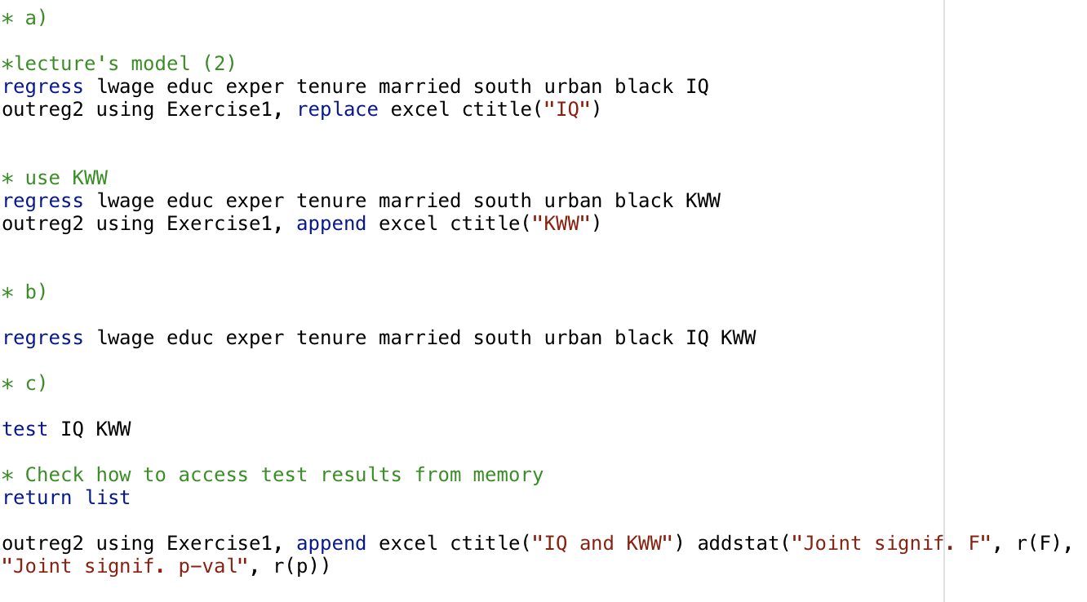
Problem Set 3 – Proxy and Instrumental Variables
 | (1) | (2) | (3)
VARIABLES | IQ - lecture | KWW | IQ and KWW
educ | 0.0544*** | 0.0576*** | 0.0498***
 | (0.00693) | (0.00684) | (0.00726)
exper | 0.0141*** | 0.0122*** | 0.0128***
 | (0.00317) | (0.00324) | (0.00323)
tenure | 0.0114*** | 0.0111*** | 0.0109***
 | (0.00244) | (0.00246) | (0.00245)
married | 0.200*** | 0.189*** | 0.192***
 | (0.0388) | (0.0391) | (0.0389)
south | -0.0802*** | -0.0916*** | -0.0820***
 | (0.0263) | (0.0262) | (0.0262)
urban | 0.182*** | 0.176*** | 0.176***
 | (0.0268) | (0.0270) | (0.0269)
black | -0.143*** | -0.164*** | -0.130***
 | (0.0395) | (0.0385) | (0.0399)
IQ | 0.00356*** |  | 0.00312***
 | (0.000992) |  | (0.00101)
KWW |  | 0.00503*** | 0.00383**
 |  | (0.00182) | (0.00185)
Constant | 5.176*** | 5.359*** | 5.176***
 | (0.128) | (0.114) | (0.128)
Observations | 935 | 935 | 935
R-squared | 0.263 | 0.259 | 0.266
Joint signif. F |  |  | 8.595
Joint signif. p-val |  |  | 0.000200
Standard errors in parentheses
*** p<0.01, ** p<0.05, * p<0.1
Exercise 3.1
Extra: Stata code to produce table
Tip: Stata’s Outreg2 command was used to create the table. Run ”ssc install outreg2” to install and ”help outreg2” to familiarize yourself with functionalities.

Slide 5
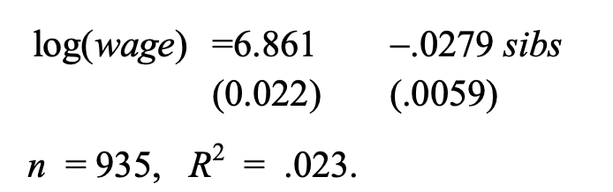
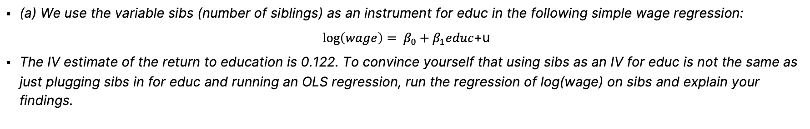
Problem Set 3 – Proxy and Instrumental Variables
Exercise 3.2
(a) We use the variable sibs (number of siblings) as an instrument for educ in the following simple wage regression:
$$\log\left(wage\right)= β_{0}+β_{1}educ\text{+}\text{u}$$
The IV estimate of the return to education is 0.122. To convince yourself that using sibs as an IV for educ is not the same as just plugging sibs in for educ and running an OLS regression, run the regression of log(wage) on sibs and explain your findings.
This is a reduced form regression equation. It shows that, controlling for no other factors, one more sibling in the family is associated with monthly salary that is about 2.8% lower. The t-statistic on sibs is about –4.72. Intuitively, sibs can be correlated with many things that should have a bearing on wage including, as we already saw, years of education.
Note: Use WAGE2.dta for this exercise.
Notes:
A difference between proxy and IV is that a proxy addresses the issue with having an unmeasurable variable affecting y, while an instrument explains the unobservable factors affecting the endogenous variable (x*) and only affects y through x*
Key conditions for an IV: Relevance/identified (testable) and exclusion (non-testable - you need to make a convincing intuitive/theoretical argument)

Slide 6
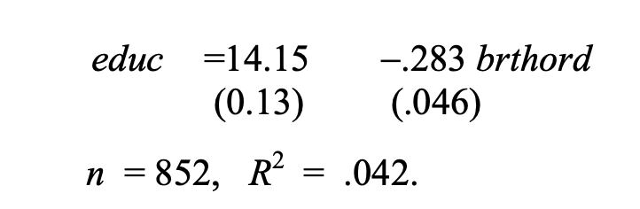

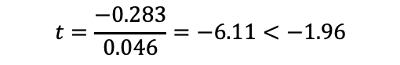
Problem Set 3 – Proxy and Instrumental Variables
Exercise 3.2
(b) The variable brthord is birth order (brthord is one for a first-born child, two for a second born child, and so on).
Explain why educ and brthord might be negatively correlated.
Regress educ on brthord to determine whether there is a statistically significant negative correlation.
It could be that older children are given priority for higher education, and families may hit budget constraints and may not be able to afford as much education for children born later.
How can we use this to assess if brthord is statistically significant? I.e. if it might be a relevant instrument for education.
$$t=\frac{−0.283}{0.046}=−6.11<−1.96$$
What is the difference in predicted education for a first and fourth born?
$$−0.283 ∗3 =−0.85 years$$
Note: Use WAGE2.dta for this exercise.

Slide 7
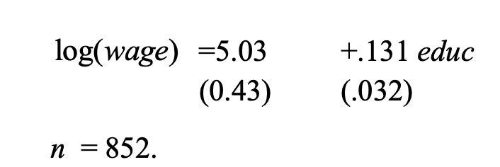
Problem Set 3 – Proxy and Instrumental Variables
Exercise 3.2
(c) Use brthord as an IV for educ in the model of part (a). Report and interpret the results.
(The R-squared is negative.) This is much higher than the OLS estimate (.060) and even above the estimate when sibs is used as an IV for educ (.122). Because of missing data on brthord, we are using fewer observations than in the previous analyses.
Note: Use WAGE2.dta for this exercise.

Slide 8
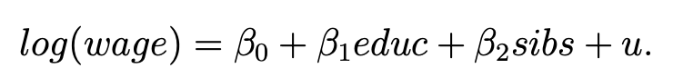
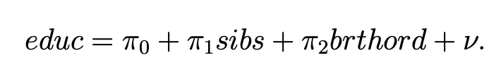
Problem Set 3 – Proxy and Instrumental Variables
Exercise 3.2
(d) Now, suppose that we include number of siblings as an explanatory variable in the wage equation; this controls for family background, to some extent:
Suppose that we want to use brthord as an IV for educ, assuming that sibs is exogenous. The reduced form for educ is:
State and test the identification assumption.
The identification assumption (that $β_{1}$is identified) holds if$π_{2}≠0$.
To test the assumption we can formulate the H0 that $π_{2}=0$ and HA: $π_{2}≠0$
The estimation of the equation yields a t-staticts of $π_{2}=−2.68$ and p-value = 0.008 which rejects H0 fairly strongly implying that the identification restriction holds.
Note: Use WAGE2.dta for this exercise.

Slide 9
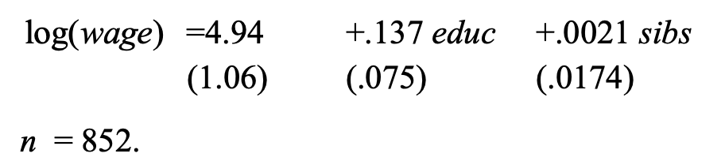
Problem Set 3 – Proxy and Instrumental Variables
Exercise 3.2
(e) Estimate the model from part (d) using brthord as an IV for educ (and sibs as its own IV). Comment on the standard errors for $β_{educ}$and $β_{sibs}$.
The standard error on $\hat{β_{educ}}$is more than twice the size of what we obtained in part (c) where we did not inlcude sibs (there the error was 0.032). The standard error of $\hat{β_{sibs}}$is very large relative to the coefficient estimate, rendering sibs very insignificant.
(f) Using the fitted values from part (d) $\hat{educ}$ from:
compute the correlation between $\hat{educ}$and sibs. Use this result to explain your findings from part (e).
Corr($\hat{educ},sibs)=−0.930$ which is which is a very strong negative correlation. This means that, for the purposes of using IV, multicollinearity is a serious problem here, and is not allowing us to estimate $\hat{educ}$with much precision.
Extra voluntary at-home exercise: Compare all the estimates for retrun to education (both in terms of coefficient estimate and standard error) across exercise 3.1 and 3.2 and reflect on the differences and similarities between the different approaches to address the OVB due to unobserved ability.
Note: Use WAGE2.dta for this exercise.

Slide 10
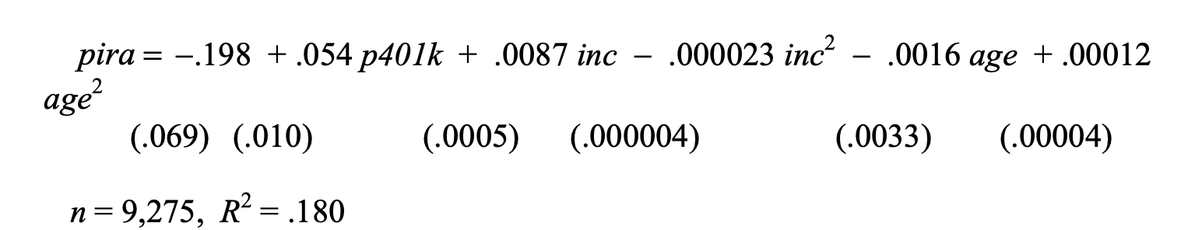
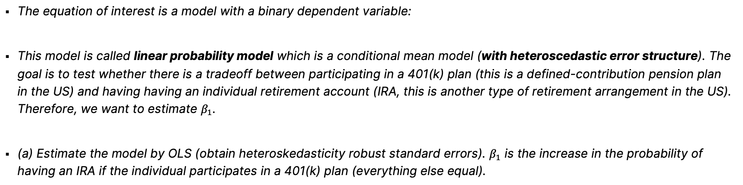
Problem Set 3 – Proxy and Instrumental Variables
Exercise 3.3
The equation of interest is a model with a binary dependent variable:
This model is called linear probability model which is a conditional mean model (with heteroscedastic error structure). The goal is to test whether there is a tradeoff between participating in a 401(k) plan (this is a defined-contribution pension plan in the US) and having having an individual retirement account (IRA, this is another type of retirement arrangement in the US). Therefore, we want to estimate $β_{1}$.
(a) Estimate the model by OLS (obtain heteroskedasticity robust standard errors). $β_{1}$ is the increase in the probability of having an IRA if the individual participates in a 401(k) plan (everything else equal).
The coefficient on p401k implies that participation in a 401(k) plan is associated with a .054 (percentage point) higher probability of having an individual retirement account, holding income and age fixed.
Note: Use 401KSUBS.dta for this exercise.

Slide 11
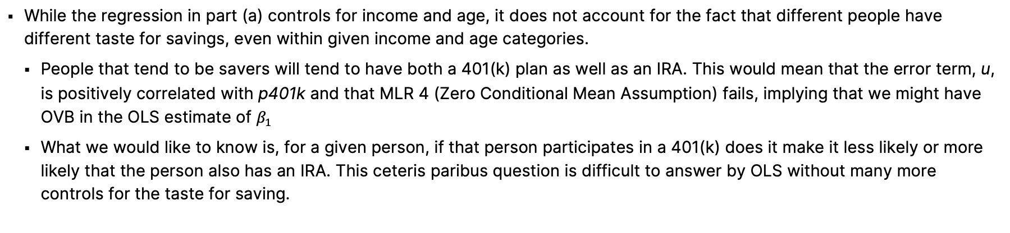
Problem Set 3 – Proxy and Instrumental Variables
Exercise 3.3
(b) For the purpose of estimating the ceteris paribus tradeoff between participation in two different types of retirement savings plan, what might be a problem with OLS?
While the regression in part (a) controls for income and age, it does not account for the fact that different people have different taste for savings, even within given income and age categories.
People that tend to be savers will tend to have both a 401(k) plan as well as an IRA. This would mean that the error term, u, is positively correlated with p401k and that MLR 4 (Zero Conditional Mean Assumption) fails, implying that we might have OVB in the OLS estimate of $β_{1}$
What we would like to know is, for a given person, if that person participates in a 401(k) does it make it less likely or more likely that the person also has an IRA. This ceteris paribus question is difficult to answer by OLS without many more controls for the taste for saving.
Note: Use 401KSUBS.dta for this exercise.

Slide 12
Problem Set 3 – Proxy and Instrumental Variables
Exercise 3.3
(c) The variable e401k is a binary variable equal to one if a worker is eligible to participate in a 401(k) plan. Explain what is required for e401k to be a valid IV for p401k. Do these assumptions seem reasonable?
We need it to satisfy two conditions:
e401k needs to be partially correlated with p401k. TESTABLE
Intuitively, this seems plausible as being eligible for a 401(k) plan is, by definition, necessary for participation.
e401k should be exogenous in the structural model. UNTESTABLE
This would imply that being eligible for a 401(k) is not correlated with unobserved taste for saving. If we think workers that like to save for retirement will match up with employers that provide vehicles for retirement saving, then u and e401k would be positively correlated and the assumption would fail.
Certainly we think that e401k is less correlated with u than is p401k. But remember, this alone is not enough to ensure that the IV estimator has less asymptotic bias than the OLS estimator.
Note: Use 401KSUBS.dta for this exercise.

Slide 13
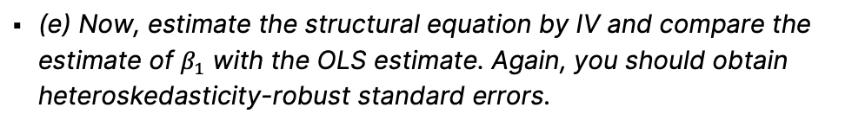
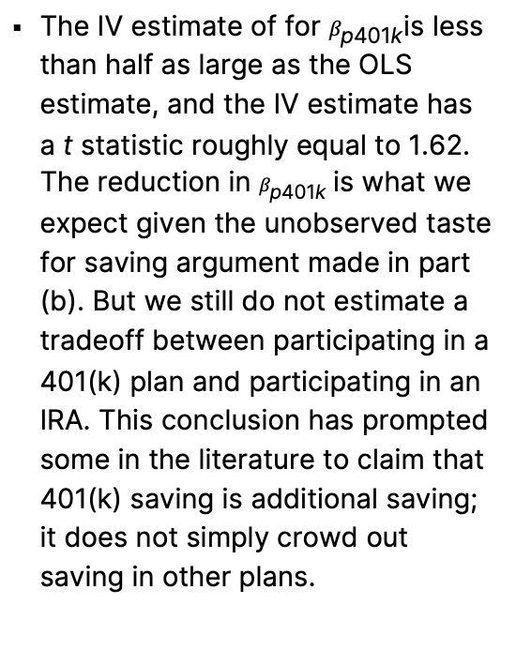
Problem Set 3 – Proxy and Instrumental Variables
Exercise 3.3
(d) Estimate the reduced form/first stage for p401k and verify that e401k has significant partial correlation with p401k (use heteroskedasticity robust standard errors).
(e) Now, estimate the structural equation by IV and compare the estimate of $β_{1}$ with the OLS estimate. Again, you should obtain heteroskedasticity-robust standard errors.
The t statistic on e401k is over 85, and its coefficient estimate implies that, holding income and age fixed, eligibility in a 401(k) plan increases the probability of participation in a 401(k) by .69 percentage points. Clearly, e401k passes one of the two requirements as an IV for p401k.
 | First Stage /
VARIABLES | Reduced Form
e401k | 0.689***
 | (0.00799)
inc | 0.00111***
 | (0.000343)
incsq | 1.84e-06
 | (2.67e-06)
age | -0.00472**
 | (0.00224)
agesq | 5.20e-05**
 | (2.57e-05)
Constant | 0.0591
 | (0.0462)
Observations | 9,275
R-squared | 0.596
Robust standard errors in parentheses
*** p<0.01, ** p<0.05, * p<0.1
The IV estimate of for $β_{\text{p}\text{401}\text{k}}$is less than half as large as the OLS estimate, and the IV estimate has a t statistic roughly equal to 1.62. The reduction in $β_{\text{p}\text{401}\text{k}}$is what we expect given the unobserved taste for saving argument made in part (b). But we still do not estimate a tradeoff between participating in a 401(k) plan and participating in an IRA. This conclusion has prompted some in the literature to claim that 401(k) saving is additional saving; it does not simply crowd out saving in other plans.
 | (1) | (2)
VARIABLES | OLS - LPM | IV
p401k | 0.0537*** | 0.0207
 | (0.0103) | (0.0132)
inc | 0.00868*** | 0.00900***
 | (0.000484) | (0.000491)
incsq | -2.28e-05*** | -2.41e-05***
 | (3.86e-06) | (3.88e-06)
age | -0.00159 | -0.00115
 | (0.00324) | (0.00325)
agesq | 0.000117*** | 0.000112***
 | (3.82e-05) | (3.83e-05)
Constant | -0.198*** | -0.207***
 | (0.0652) | (0.0654)
Observations | 9,275 | 9,275
R-squared | 0.180 | 0.179
Robust standard errors in parentheses
*** p<0.01, ** p<0.05, * p<0.1
Note: Use 401KSUBS.dta for this exercise.

Slide 14
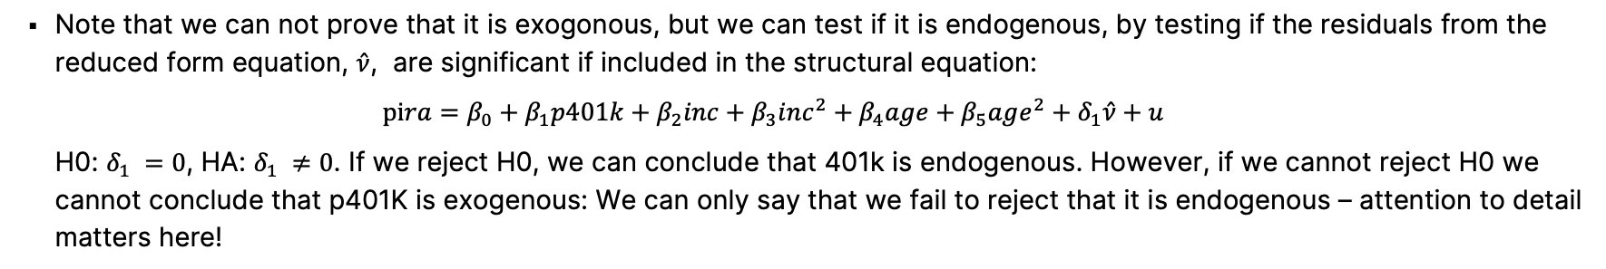
Problem Set 3 – Proxy and Instrumental Variables
Exercise 3.3
(f) Test the null-hypothesis that p401k is in fact exogenous, using a heteroskedasticity robust test.
Note that we can not prove that it is exogonous, but we can test if it is endogenous, by testing if the residuals from the reduced form equation, $\hat{ν}$, are significant if included in the structural equation:
$$pira=β_{0}+β_{1}p401k+β_{2}inc+β_{3}inc^{2}+β_{4}age+β_{5}age^{2}+δ_{1}\hat{ν}+u$$
H0: $δ_{1} =0$, HA: $δ_{1} ≠0$. If we reject H0, we can conclude that 401k is endogenous. However, if we cannot reject H0 we cannot conclude that p401K is exogenous: We can only say that we fail to reject that it is endogenous – attention to detail matters here!
$\hat{δ_{1}}=0.075$ and $t=3.92$, implying that we reject H0 and conclude that 401k is indeed endogeneous and that we should not use the OLS model in (a) to draw any conclusions on the main hypothesis of interest: I.e. on the potential tradeoff between participating in a 401k plan and having having an individual retirement account.
Note: Use 401KSUBS.dta for this exercise.

Slide 15
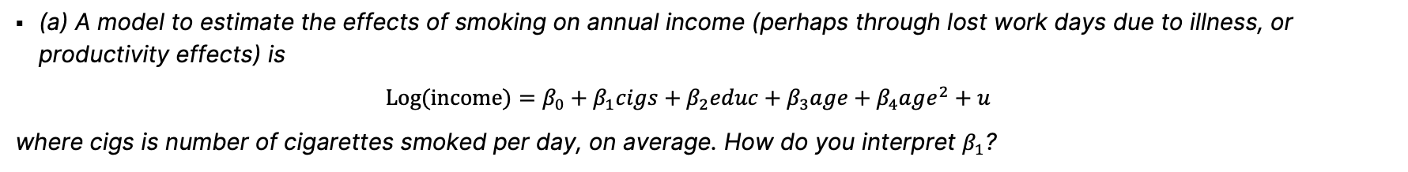
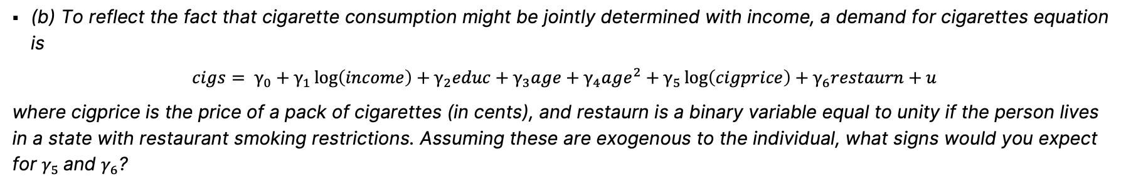
Problem Set 4, Part 1 - Simultaneous Equation Models
Exercise 4.1
(a) A model to estimate the effects of smoking on annual income (perhaps through lost work days due to illness, or productivity effects) is
$$Log(income)=β_{0}+β_{1}cigs+β_{2}educ+β_{3}age+β_{4}age^{2}+u$$
where cigs is number of cigarettes smoked per day, on average. How do you interpret $β_{1}$?
Assuming the structural equation represents a causal relationship - and remembering we have a log-level model with respect to cigs - 100⋅ $β_{1}$ is the approximate percentage change in income (= semi-elastictity) if a person smokes one more cigarette per day.
(b) To reflect the fact that cigarette consumption might be jointly determined with income, a demand for cigarettes equation is
$$cigs= γ_{0}+γ_{1}\log\left(income\right)+γ_{2}educ+γ_{3}age+γ_{4}age^{2}+γ_{5}\log\left(cigprice\right)+γ_{6}restaurn+u$$
where cigprice is the price of a pack of cigarettes (in cents), and restaurn is a binary variable equal to unity if the person lives in a state with restaurant smoking restrictions. Assuming these are exogenous to the individual, what signs would you expect for $γ_{5}$and $γ_{6}$?
Since consumption and price are, ceteris paribus, negatively related, we expect $γ_{5}$≤ 0 (allowing for $γ_{5}$) = 0. Similarly, everything else equal, restaurant smoking restrictions should reduce cigarette smoking, so $γ_{6}$ ≤ 0.
Note: Use SMOKE.DTA for this exercise.

Slide 16
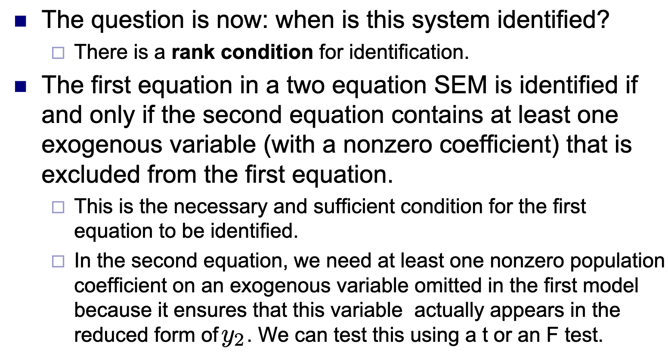
Problem Set 4, Part 1 - Simultaneous Equation Models
Exercise 4.1
(c) Under what assumptions is the income equation from part (a) identified?
We need $γ_{5}$ or $γ_{6}$to be different from zero. That is, we need at least one exogenous variable in the cigs equation that is not also in the log(income) equation.
Note: Use SMOKE.DTA for this exercise. Ralf’s slide 21

Slide 17
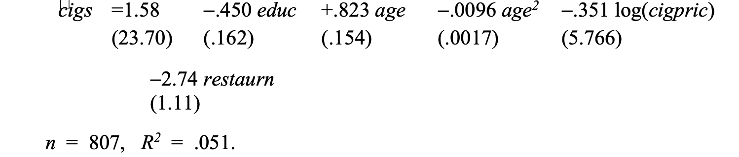
Problem Set 4, Part 1 - Simultaneous Equation Models
Exercise 4.1
(d) Estimate the reduced form/first stage for cigs. (Recall that this entails regressing cigs on all exogenous variables.) Are log(cigprice) and restaurn significant in the reduced form?
While log(cigpric) is very insignificant, restaurn had the expected negative sign and a t-statistic of about –2.47. (People living in states with restaurant smoking restrictions smoke almost three fewer cigarettes, on average, given education and age.) We could drop log(cigpric) from the analysis but we leave it in. (Incidentally, the F test for joint significance of log(cigpric) and restaurn yields p-value ≈ .044, so we cannot reject that they are jointly significant.)
Note: Use SMOKE.DTA for this exercise.

Slide 18
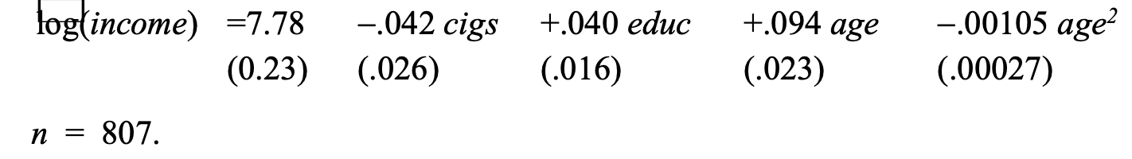
Problem Set 4, Part 1 - Simultaneous Equation Models
Exercise 4.1
(e) Now, estimate the income equation by 2SLS. Discuss how the estimate of $β_{1}$ compares with the OLS estimate.
Now the coefficient on cigs is negative and almost significant at the 10% level against a two-sided alternative (t$=\frac{0.42}{0.26}=1.62$ and the critical value for $α=0.10$ is 1.645). The estimated effect is very large: each additional cigarette someone smokes lowers predicted income by about (100*$β_{1}$=) 4.2%.
(f) Do you think that cigarette prices and restaurant smoking restrictions are exogenous in the income equation?
Assuming that state level cigarette prices and restaurant smoking restrictions are exogenous in the income equation is problematical. Incomes are known to vary by region, as do restaurant smoking restrictions. It could be that in states where income is lower (after controlling for education and age), restaurant smoking restrictions are less likely to be in place.
Note: Use SMOKE.DTA for this exercise.

Slide 19
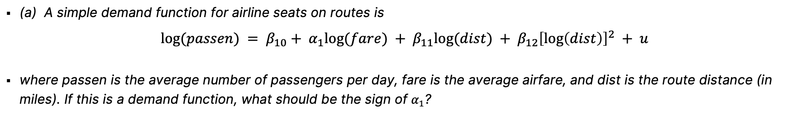
Problem Set 4, Part 1 - Simultaneous Equation Models
Exercise 4.2
(a) A simple demand function for airline seats on routes is
$log⁡(passen) = β_{10}+ α_{1}log⁡(fare) + β_{11}log⁡(dist) + β_{12}{\left[\log\left(dist\right)\right]}^{2} + u$
where passen is the average number of passengers per day, fare is the average airfare, and dist is the route distance (in miles). If this is a demand function, what should be the sign of $α_{1}$?
The demand function should be downward sloping, so $α_{1}$ < 0: as price increases, quantity demanded for air travel decreases.
(b) Estimate the equation from part (a) by OLS. What is the estimated price elasticity?
The price elasticity, $\hat{α_{1},}$is -0.391 implying that a 1 % increase in average airfare is expected to decrease the number of passengers per day by 0.391%. Note that the negative sign confirms our assumption from (a).
(c) Consider the variable concen, which is a measure of market concentration. (The share of business accounted for by the largest carrier.) Explain what we must assume to treat concen as exogenous in the demand equation.
We must assume that passenger demand depends only on air fare, so that, once price is controlled for, passengers are indifferent about the fraction of travel accounted for by the largest carrier.
Note: Use airfare.DTA (for year 1997 only) for this exercise.

Slide 20
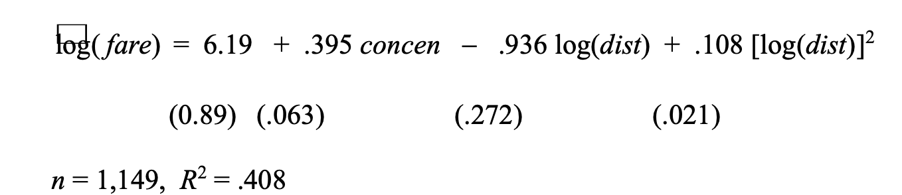
Problem Set 4, Part 1 - Simultaneous Equation Models
Exercise 4.2
(d) Now assume that concen is exogenous to the demand equation. Estimate the reduced form for log(fare) and confirm that concen has a positive partial effect on log(fare).
The coefficient on concen shows a pretty strong link between concentration and fare. If concen increases by .10 (=10 percentage points), fare is estimated to increase by almost 4% ($≈0.10∗0.395$). The t statistic is about 6.3.
(e) Estimate the demand equation using IV (with concen as the instrument). Now, what is the estimated price elasticity of demand? How does it compare with the OLS estimate from (b)?
Using concen as an IV for log(fare), the estimated price elasticity is −1.17, which shows much greater price sensitivity than did the OLS estimate of -0.391. The IV estimate suggests that a one percent increase in fare leads to a slightly more than one percent increase drop in passenger demand. Of course, the standard error of the IV estimate is much larger (about .389 compared with the OLS standard error of .067), but the IV estimate is still statistically significant (t is about −3.0).
Note: Use airfare.DTA (for year 1997 only) for this exercise.

Slide 21
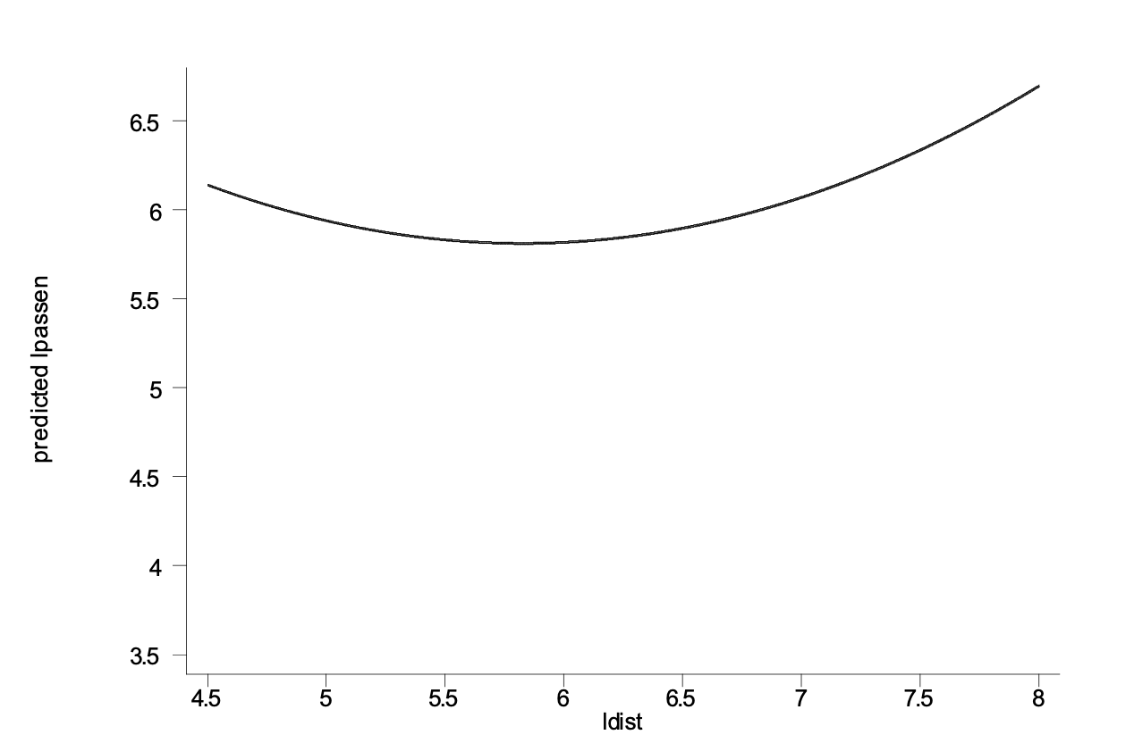
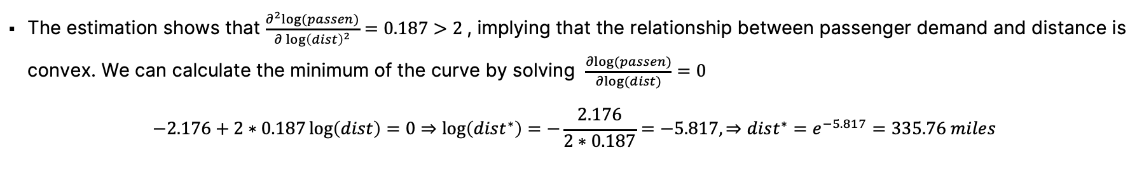
Problem Set 4, Part 1 - Simultaneous Equation Models
Exercise 4.2
(f) Using the IV estimates, describe how demand for seats depends on route distance.
VARIABLES | lpassen
lfare | -1.174***
 | (0.389)
ldist | -2.176***
 | (0.727)
ldistsq | 0.187***
 | (0.0613)
Constant | 18.01***
 | (3.222)
Observations | 1,149
Standard errors in parentheses
*** p<0.01, ** p<0.05, * p<0.1
The estimation shows that $\frac{∂^{2}log⁡(passen)}{∂{\log\left(dist\right)}^{2}}=0.187>2$, implying that the relationship between passenger demand and distance is convex. We can calculate the minimum of the curve by solving $\frac{∂log⁡(passen)}{∂log⁡(dist)}=0$
$$−2.176+2∗0.187\log\left(dist\right)=0⇒\log\left(dist^{∗}\right)=−\frac{2.176}{2∗0.187}=−5.817, ⇒dist^{∗}=e^{−5.817}=335.76 miles$$
Note: Use airfare.DTA (for year 1997 only) for this exercise.

Slide 22
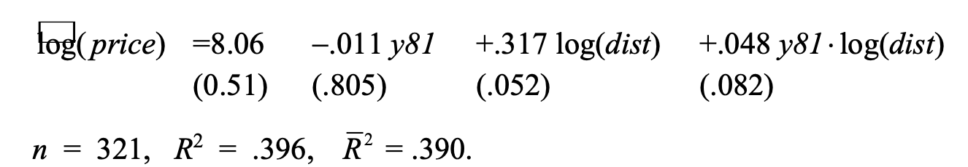
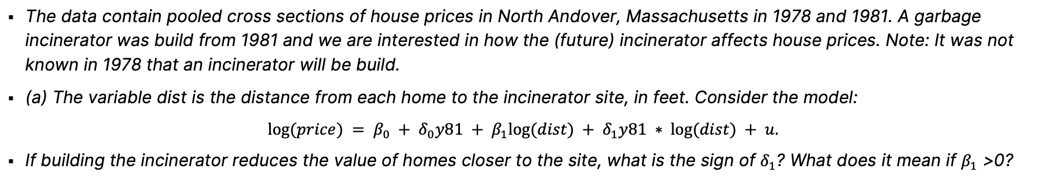
Problem Set 4, Part 2 - Pooled Cross Section Models
Exercise 4.3
The data contain pooled cross sections of house prices in North Andover, Massachusetts in 1978 and 1981. A garbage incinerator was build from 1981 and we are interested in how the (future) incinerator affects house prices. Note: It was not known in 1978 that an incinerator will be build.
(a) The variable dist is the distance from each home to the incinerator site, in feet. Consider the model:
$$log⁡(price) = β_{0} + δ_{0}y81 + β_{1}log⁡(dist) + δ_{1}y81 ∗ log⁡(dist) + u.$$
If building the incinerator reduces the value of homes closer to the site, what is the sign of $δ_{1}$? What does it mean if $β_{1}$ >0?
Other things equal, homes farther from the incinerator should be worth more, so $δ_{1}$> 0. If $β_{1}$ > 0, then the incinerator was located farther away from more expensive homes, as it would imply that distance from the incenerator was asociated with a positive effect on house prices even in 1978 when there was no knowlegde of the future incenerator being build.
(b) Estimate the model from part (a) and report the results in the usual form. Interpret the coefficient on $y81 ∗ log⁡(dist)$ What do you conclude?
While $\hat{δ_{1}}$ = .048 is the expected sign, it is not statistically significant (t statistic ≈ .59)
Note: Use the data KIELMC.dta for this exercise.

Slide 23
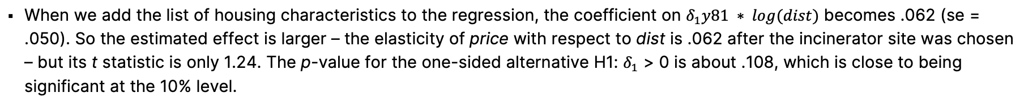
Problem Set 4, Part 2 - Pooled Cross Section Models
Exercise 4.3
(c) Add age, age2, rooms, baths, log(intst), log(land), and log(area) to the equation. Now, what do you conclude about the effect of the incinerator on housing values?
When we add the list of housing characteristics to the regression, the coefficient on $δ_{1}y81 ∗ log⁡(dist)$ becomes .062 (se = .050). So the estimated effect is larger – the elasticity of price with respect to dist is .062 after the incinerator site was chosen – but its t statistic is only 1.24. The p-value for the one-sided alternative H1: $δ_{1}$ > 0 is about .108, which is close to being significant at the 10% level.
Note: Use the data KIELMC.dta for this exercise.

